Slide 1
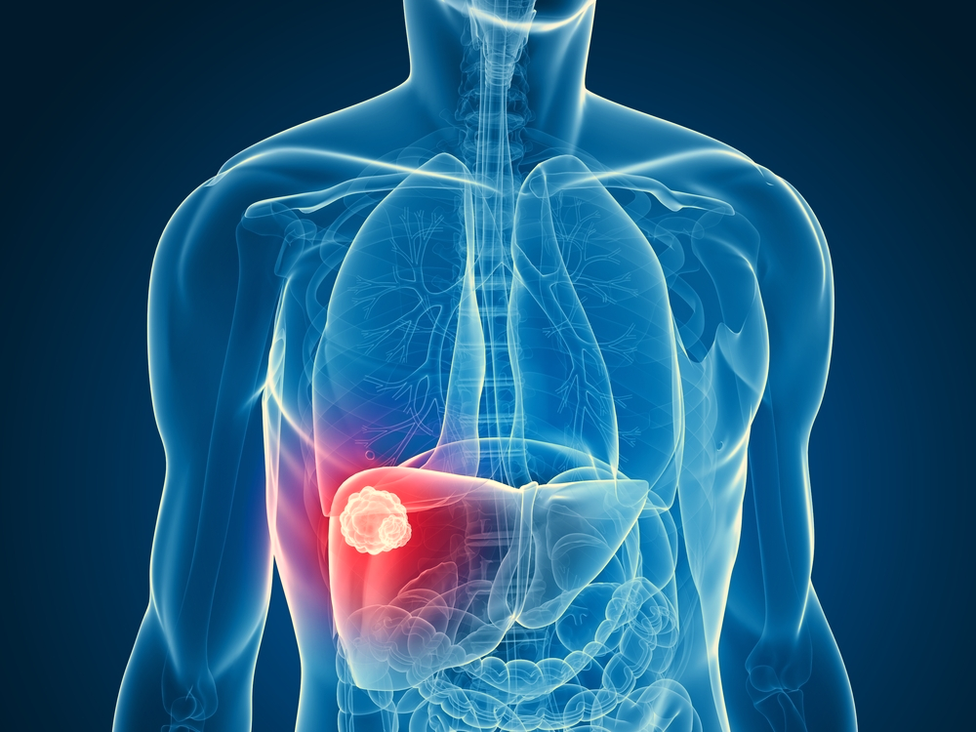
PREDICTION OF CHEMOTHERAPY RESPONSE IN LIVER METASTASES
Research Project - Applied Statistics 2022

Slide 2

01 ABOUT THE DISEASE
02 DATASET
CONTENTS
03 METHODOLOGY
04 OBJECTIVES
TRG for Liver Metastases
Humanitas Research Hospital
Data Exploration and PCA
Analysis and Prediction

Slide 3

THE DISEASE
Liver Metastases
Chemotherapy

Slide 4

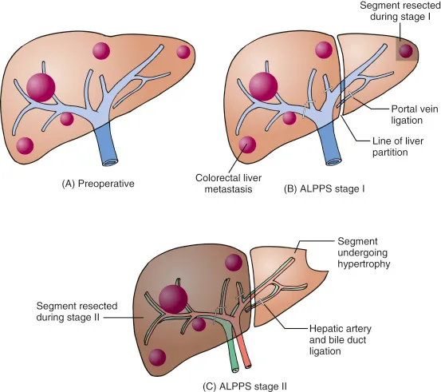
Liver metastases
affect about half of the patients with colorectal cancer
Chemotherapy
is the current standard treatment, but is also highly invasive so we are interested in understanding when the chemotherapy has been useful and when not.
Nowadays, the approach is to study the dimension of the metastases: if a reduction in dimension is observed the lesion is labelled as responsive, otherwise as non-responsive.
The Problem
In some cases it can happen that this approach is unreliable → The solution is RADIOMICS

Slide 5
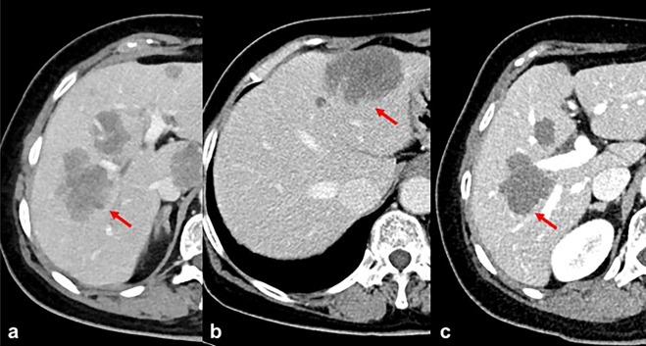
RESEARCH QUESTION
Radiomics
extracts microscopic information, not available using only a visual inspection of the images, hence provides some additional information in a non-invasive way
In this study we use both the clinical information of the patient and the radiomics features in order to build a classification model that is able to predict whether a lesion has been responsive.
The aim of this project is to leverage radiomics to predict tumor response to chemotherapy, or Tumor Regression Grade, in a non invasive way, through classification of lesions.

Slide 6
DATASET
Humanitas research
hospital

Slide 7

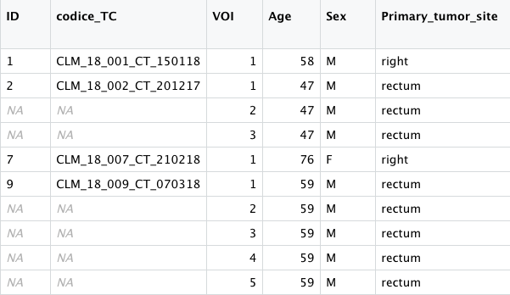
CLINICAL
VARIABLES
The data are provided by the Humanitas Clinical and Research center and consist on 127 patients and more than 70 variables divide into clinical and radiomics.
Demographic characteristics
Age, Sex
Metastases information
Number of metastases, Diameter, Marker
Chemotherapy information
Drugs, Number of cycles, Number of lines
Each row corresponds to a single lesion,
a patient can have more than one lesion.
RADIOMIC
The dataset contains 50 features for the core region and the same amount for the margin.
Radiomic variables are extracted from patient CT scans.
From this phase two regions of interest are segmented: the CORE of the tumor and the MARGIN, that is a 5-mm region around the tumor.

Slide 8
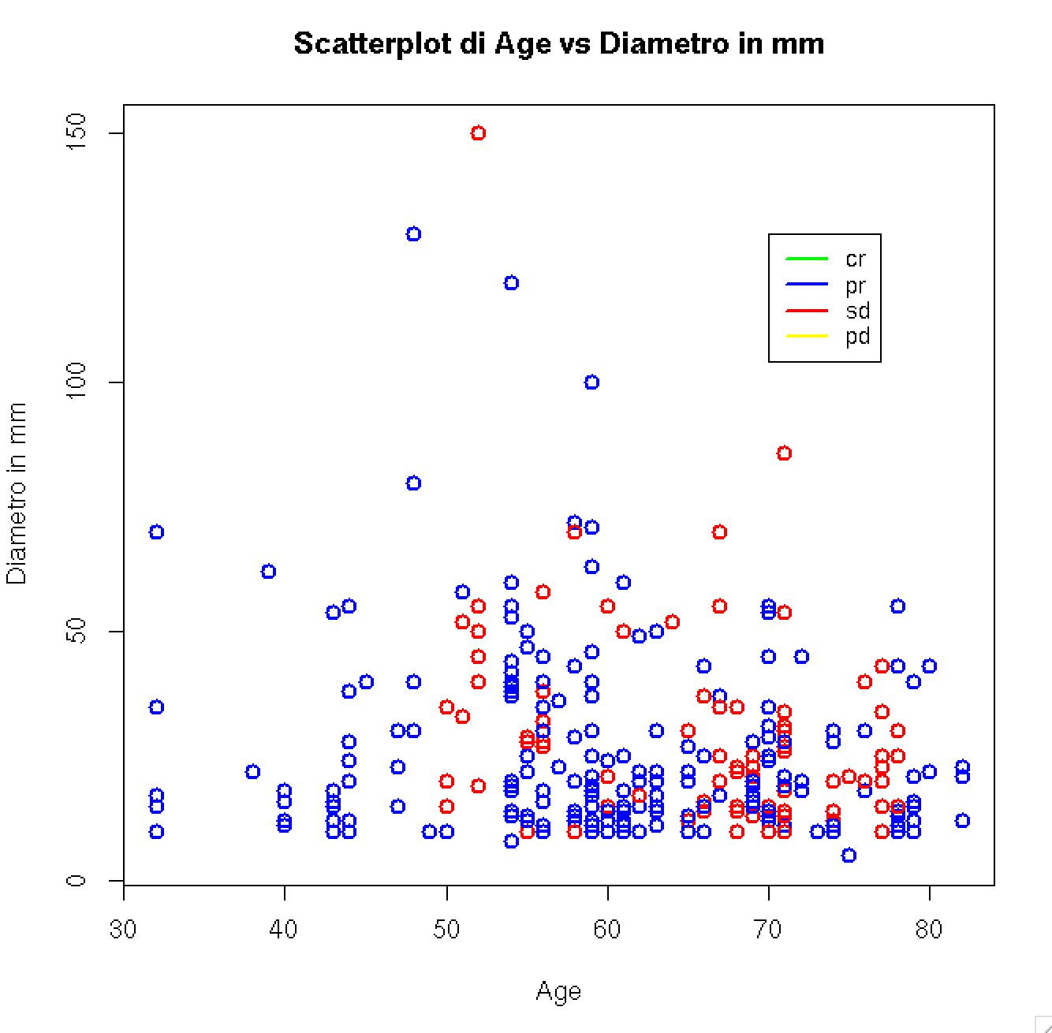
OUTCOMES
Radiological response to chemotherapy
CR complete response
PR partial response
SD stable disease
PD progressive
Histopathological response to therapy: TRG
1 complete resonse
3 partial response
5 no response

Slide 9

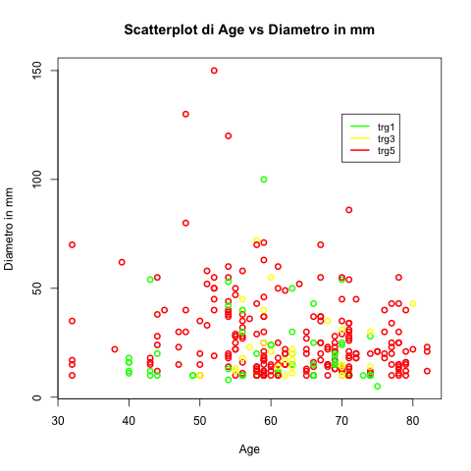
OUTCOMES
Radiological response to chemotherapy
CR complete response
PR partial response
SD stable disease
PD progressive
Histopathological response to therapy: TRG
1 complete resonse
3 partial response
5 no response

Slide 10

METHODOLOGY
Data exploration
PCA

Slide 11

METHODOLOGY
EXPLORATION
CLEANING
RADIOMIC SELECTION
Histograms
Box-Plot
Selection of lesions:
dimension, capturing
Correlation
PCA

Slide 12
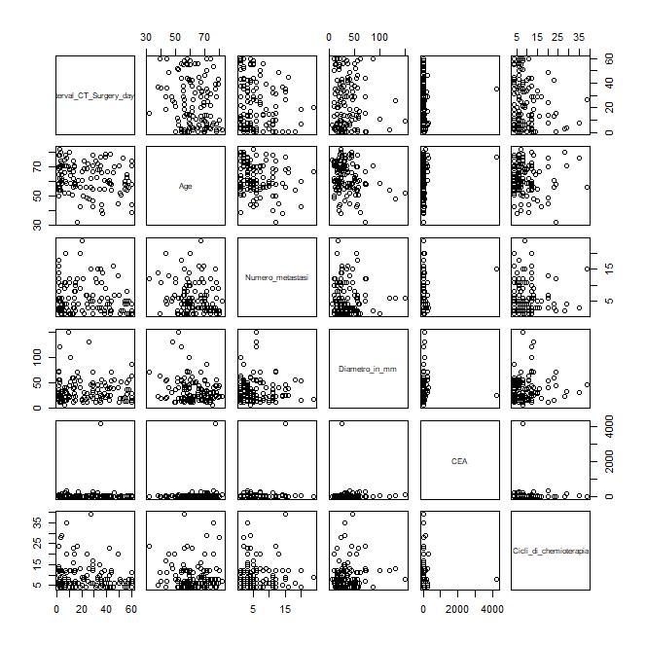
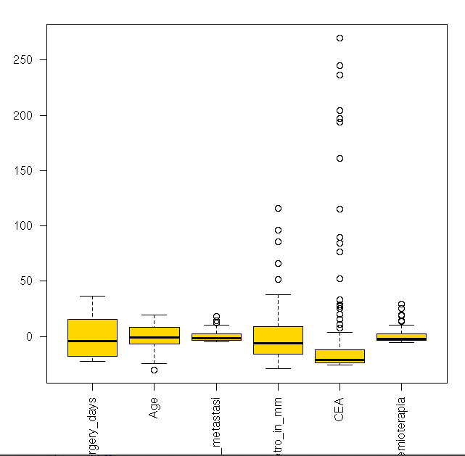
EXPLORATION
We noticed a strange behaviour of the variable CEA,
but its outliers correspond to more than 20% of patients and moreover these values ​​make medical sense in cancer conditions

Slide 13
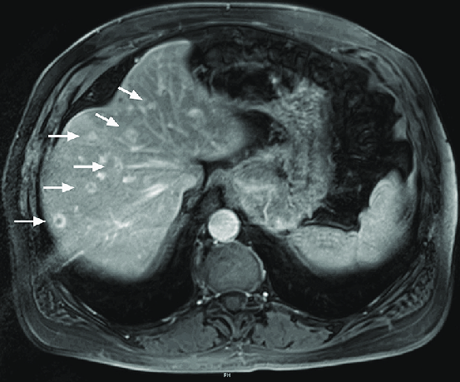
CLEANING
Selection of the most representative lesion for each patient
Greatest dimensions
Most capturing one

Slide 14
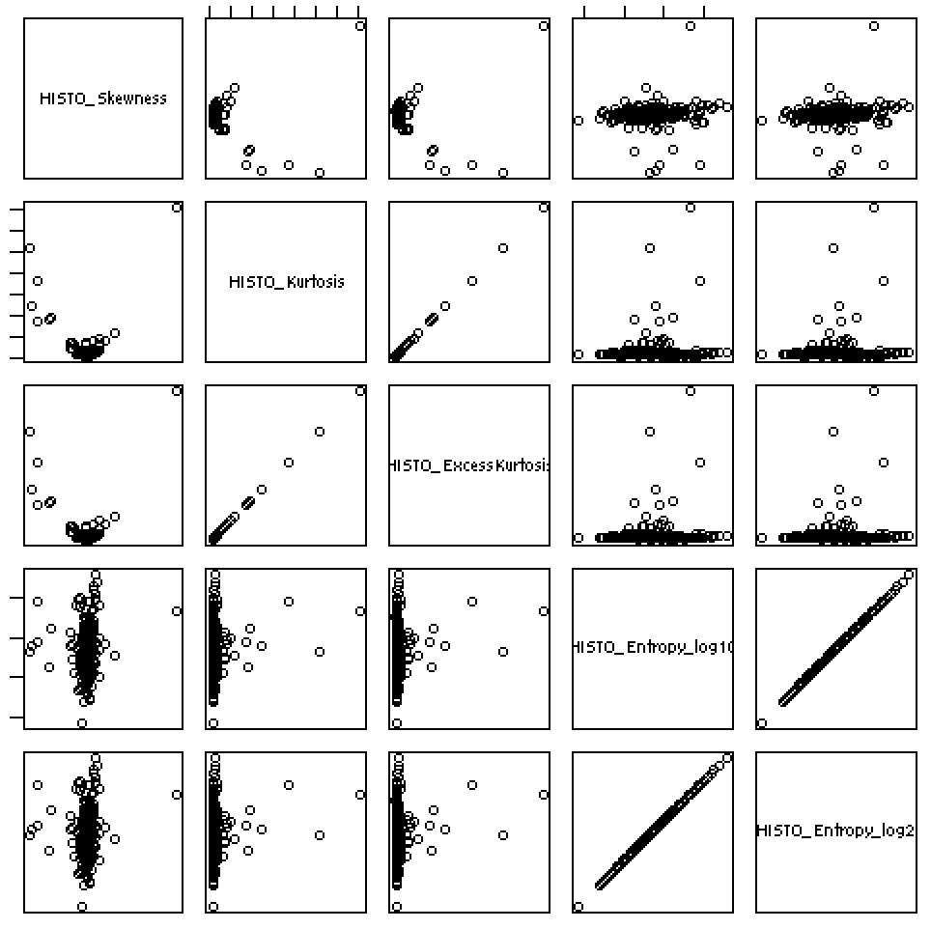
RADIOMICS SELECTION
Analysis of the correlation between the
variables
Many variables of the same statistical group are
highly correlated
From 49 radiomic variables to 35

Slide 15

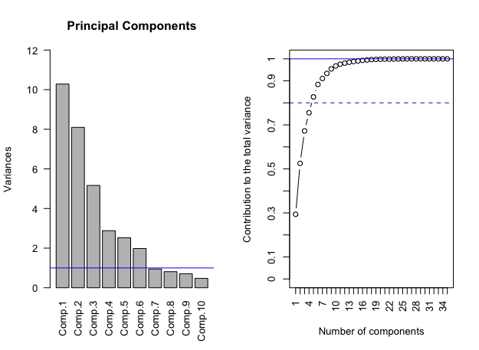
PCA
From 35 radiomics variables to 5/6.
This variables explain the 82/88 %
of variability

Slide 16
OBJECTIVES
Analysis
Prediction

Slide 17
STUDY OBJECTIVES
ANALYSIS
Analyse the utility of adding the radiomic features from the core, the margin or both
BUILD A MODEL
RESEARCH
1. Clinical
2. Radiomic
3. Clinical + Radiomic
Custering and Risk Stratification, influence of age, type of chemoterapy on TRG

Slide 18
MAIN OBJECTIVES
Build a model using only the clinical variables that work as baseline
Analyse the utility of adding only the radiomic features extracted from the core
Analyse the utility of adding also the radiomic features extracted from the margin
Analyse the possibility of adding only the radiomic features of the first order for both regions of interest
ANALYSIS & RESEARCH
Clustering
How to represent patients? How to measure the distance between patients?
Risk Stratification
find a representation of patients and try to cluster with the radiomics variables and interpret it on the basis of the clinical
Model selection
compare the model using pca and a ridge/lasso model with the original variables

Slide 19


